Slide 1

FAKE NEWS DETECTION USING MACHINE LEARNING
Presented By
Student Name:KUTHADI MANASA VENKATA NAGA SRUTHI
College Name:DMSSVH COLLEGE OF ENGINEERING
Department: CSE
Email ID: km1842376@gmail.com
AICTE Student ID:STU652e56f366d251697535731
AINSI_115449

Slide 2
OUTLINE
Problem Statement
Proposed System/Solution
System Development Approach
Algorithm & Deployment
Result
Conclusion
Future Scope
References

Slide 3
Problem Statement
In the digital age, the spread of misinformation and fake news has become a significant concern. With the rapid growth of social media and online platforms, it is easier than ever to circulate false information. This fake news can influence public opinion, create panic, and even affect elections and social harmony. Therefore, identifying and mitigating fake news is a pressing need in modern society.

Slide 4
Proposed Solution
We propose an AI-based Fake News Detection system that utilizes Natural Language Processing (NLP) and Machine Learning algorithms to analyze the textual content of news articles and classify them as "Real" or "Fake". The system is trained on a labeled dataset of fake and real news articles to learn patterns and linguistic features that typically indicate fake news.

Slide 5
System Approach
Technologies and Tools Used:
Programming Language: PythonLibraries: scikit-learn, pandas, numpy, matplotlib, seaborn, nltk, reML
Algorithm: Logistic Regression / PassiveAggressiveClassifierNLP
Techniques: TF-IDF vectorization, text preprocessing
IDE: Jupyter Notebook
Dataset: Kaggle - Fake News Dataset or similar

Slide 6
Algorithm & Deployment
Steps:
Data Preprocessing:
Cleaning text (removing punctuation, symbols, lowercasing)
Removing stop words and applying stemming/lemmatization
2. Vectorization:
Using TF-IDF to convert text into numerical format
3. Model Training:
Splitting data into training and testingApplying
Logistic Regression or PassiveAggressiveClassifier
4. Model Evaluation:
Accuracy Score, Confusion Matrix, Classification Report
5. Deployment (optional):
Web interface using Flask for user interaction (submit news text → get prediction)

Slide 7
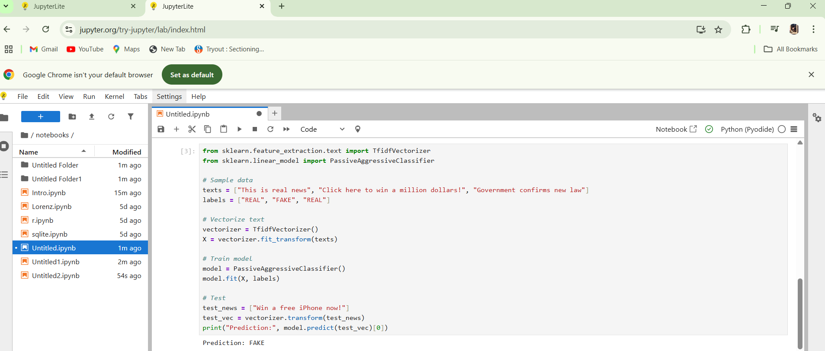
Result

Slide 8
Conclusion
Fake news detection is a vital application of AI that can contribute significantly to maintaining social harmony and spreading awareness. Our system demonstrates that machine learning models, when trained with proper data and NLP techniques, can effectively differentiate between fake and real news articles. This system can be integrated into larger platforms for real-time detection and flagging of misinformation.

Slide 9
Future scope
Integrate multilingual support for detecting fake news in various languages.
Use deep learning models like BERT or LSTM for higher accuracy.
Create a browser extension or mobile app for real-time article verification.
Enhance dataset with newer articles and social media posts for better model generalization.

Slide 10
References
Scikit-learn Documentation
Natural Language Toolkit (NLTK)
Kaggle: Fake News Dataset
Research Paper: "Detecting Fake News on Social Media: A Data Mining Perspective", ACM SIGKDD
GitHub link: https://github.com/Manasa272/Manasa_Ai-project.git

Slide 11
Thank you

